Slide 1
Project Title Deploying Azure protected Geo-Redundant Solution having path based routing.
Business Scenario
The Tyrell Crop wants to build a highly secured Globally distributed application. This application serves two types of content: images and dynamically rendered webpages. As their user base comes from across the globe this must be geographically redundant. The design demands that it should serve its users from the closest (lowest latency) location to them. For distinction, Tyrell Crop has decided that any URLs that match the pattern /images/* are served from a dedicated pool of VMs that are different from the rest of the web farm.
Requirements
Design the Load Balancing architecture for Tyrell Crop.
For this sample do it in East US region, then you can select any other region and add those Application gateways on created Traffic manager.
Resources used for Deployment: 1. Azure Virtual Networks 2. Azure Virtual Machines 3. Azure Network Security Groups
4. Azure Network Interface Card
5. Azure Application Gateway
6. Azure Traffic Manager
7. Availability Sets

Slide 2

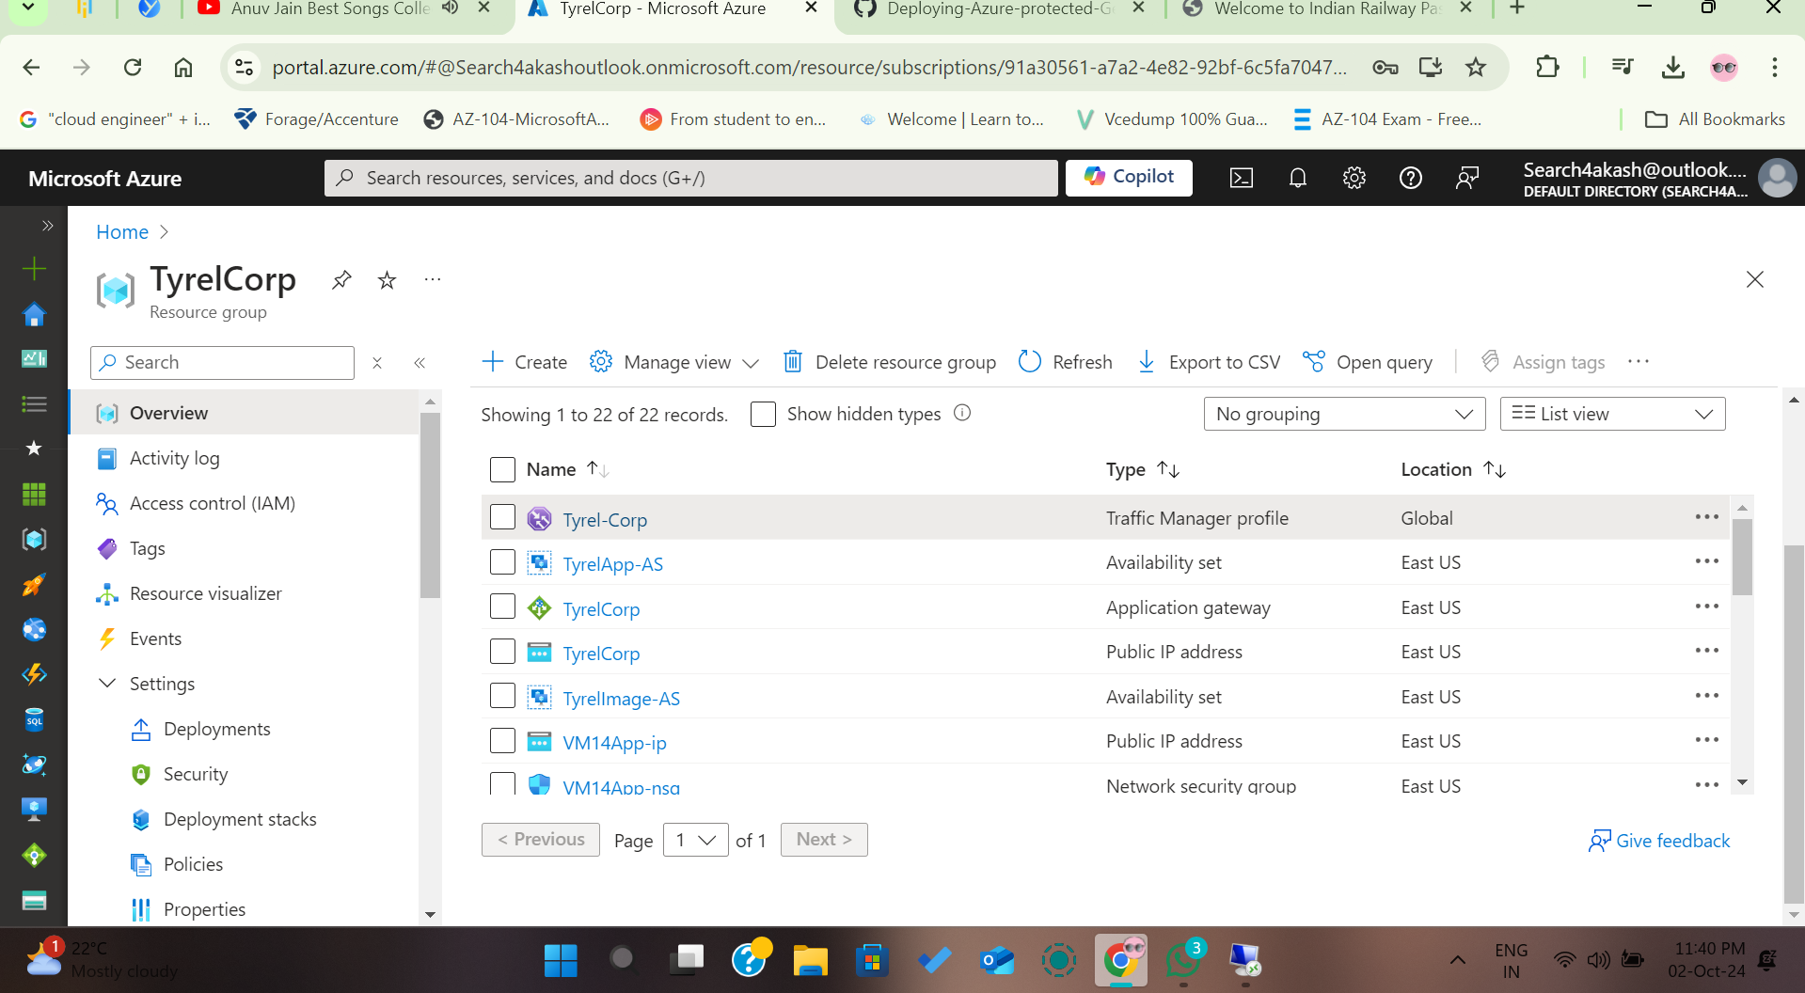
Resource Group
Akash Majumdar
Notes:
Akajoiajs

Slide 3
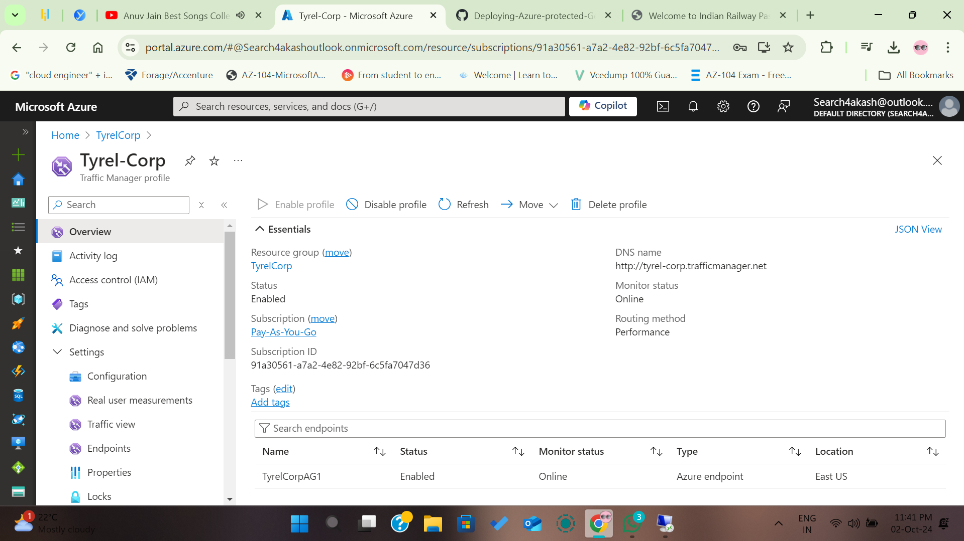
Tyrell Corp –Traffic Manager
Akash Majumdar

Slide 4
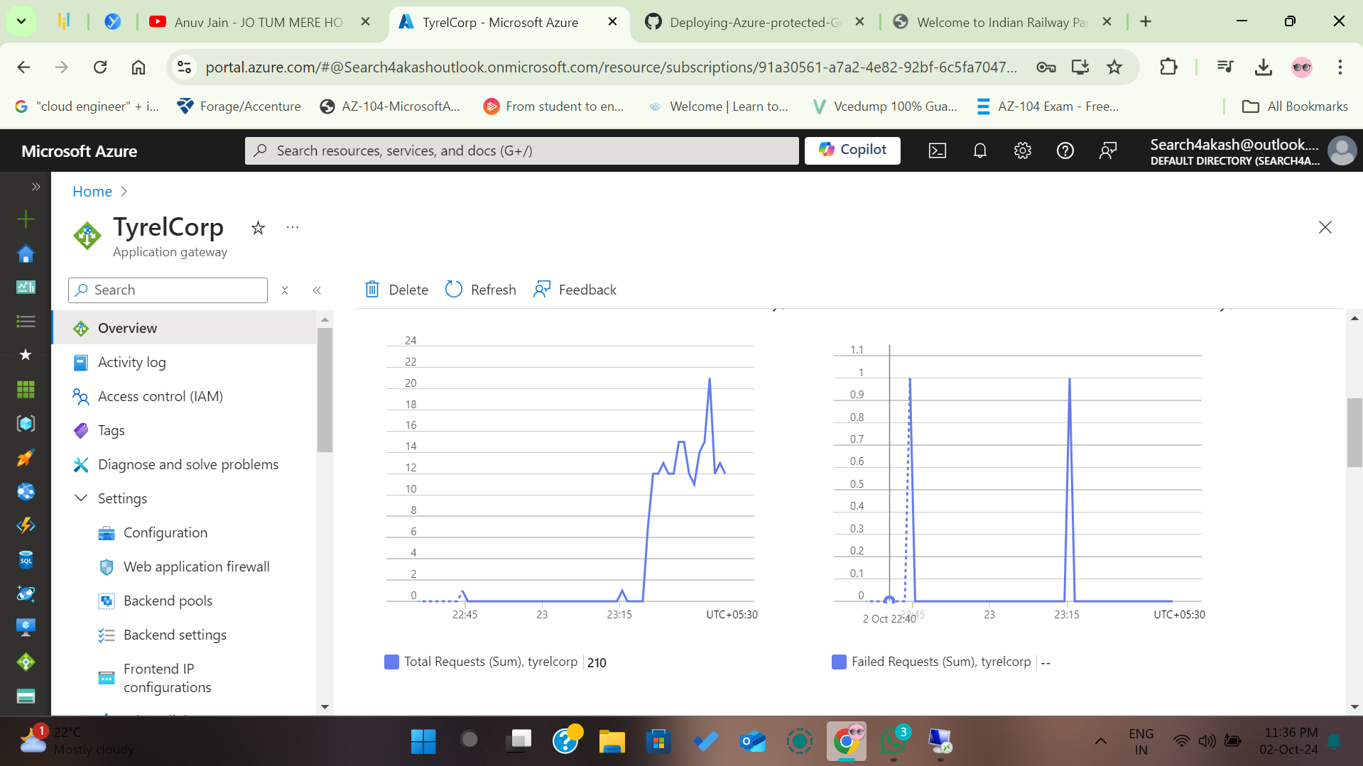
Application Gateway
Akash Majumdar

Slide 5
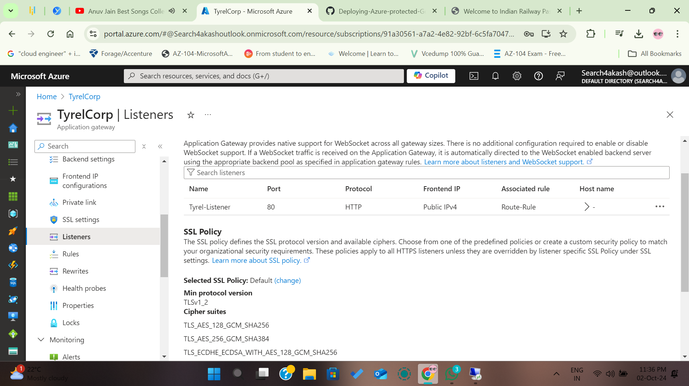
TyrellCorp - Listeners
Akash Majumdar

Slide 6
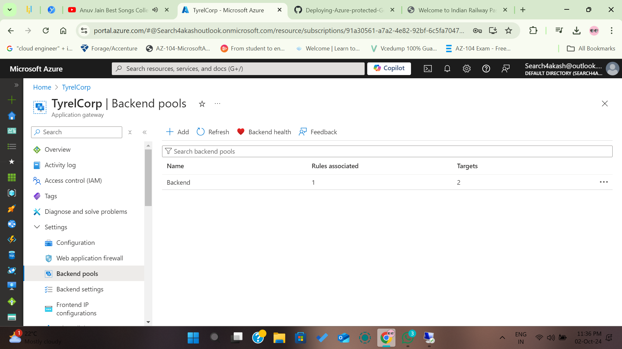
Backend - Pool
Akash Majumdar

Slide 7
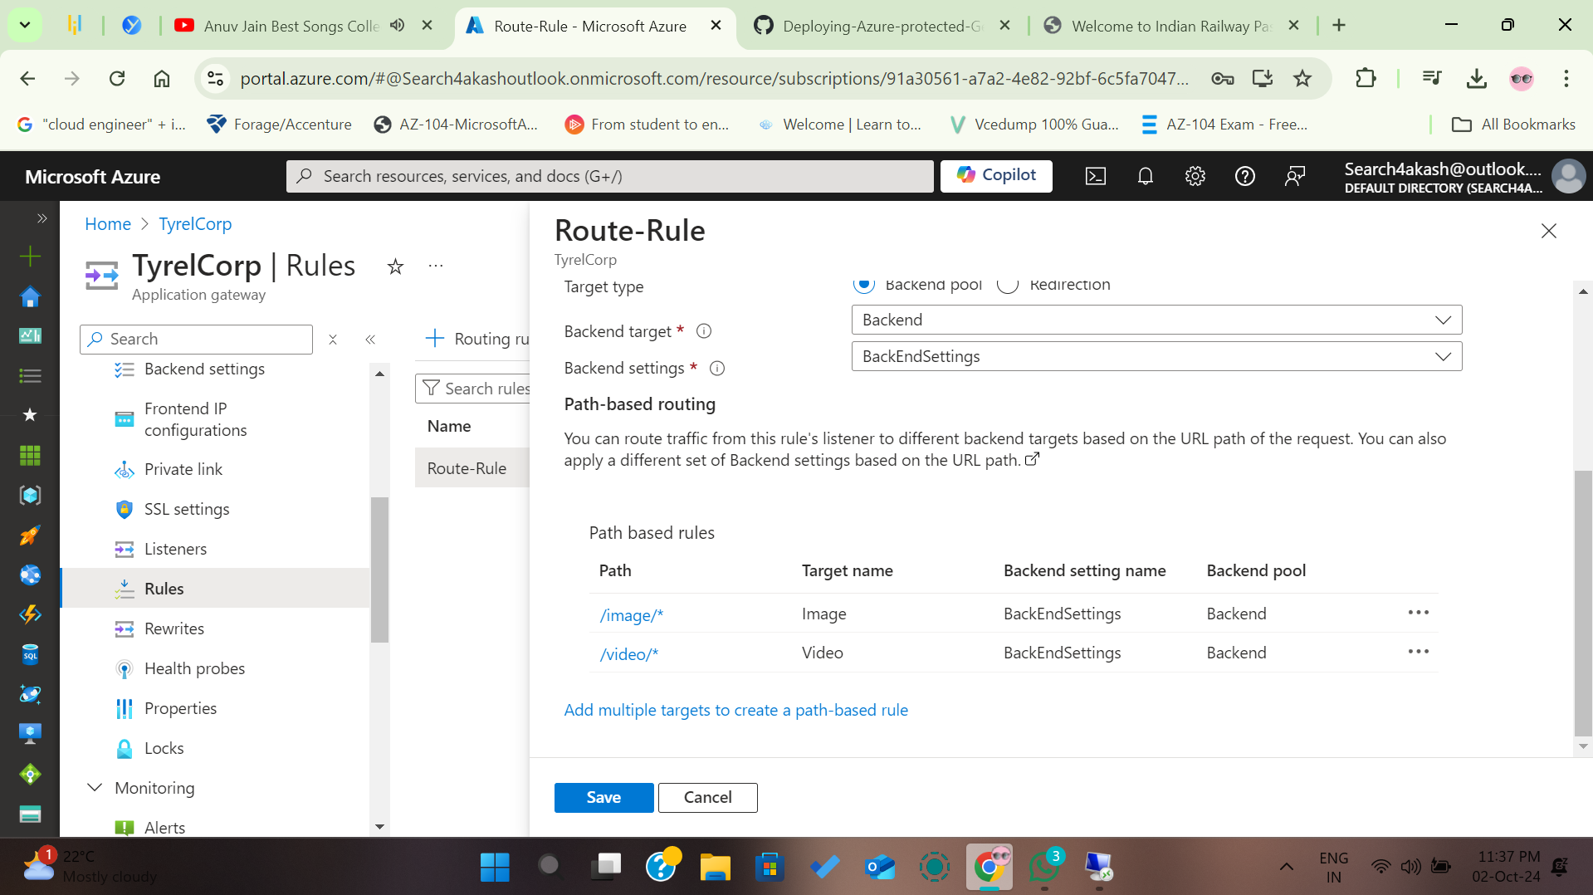
Path-Based Routing
Akash Majumdar

Slide 8
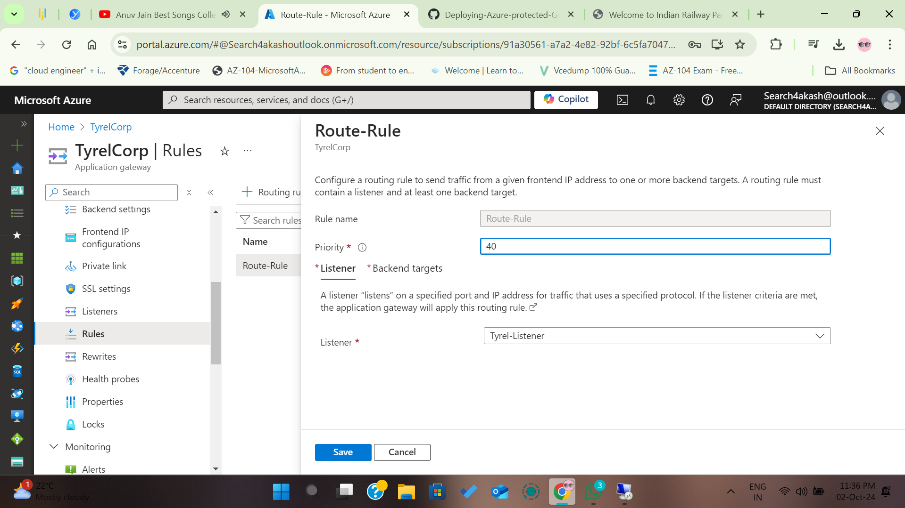
Route-Rule Listeners
Akash Majumdar

Slide 9
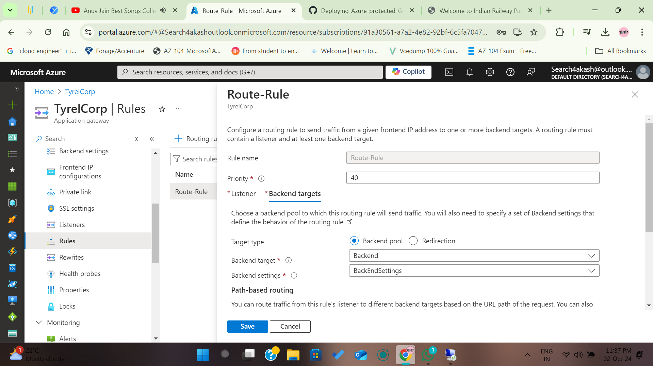
Route-Rule BackEnd
Akash Majumdar

Slide 10
Route-Rule Target (Image/Video)
Akash Majumdar

Slide 11
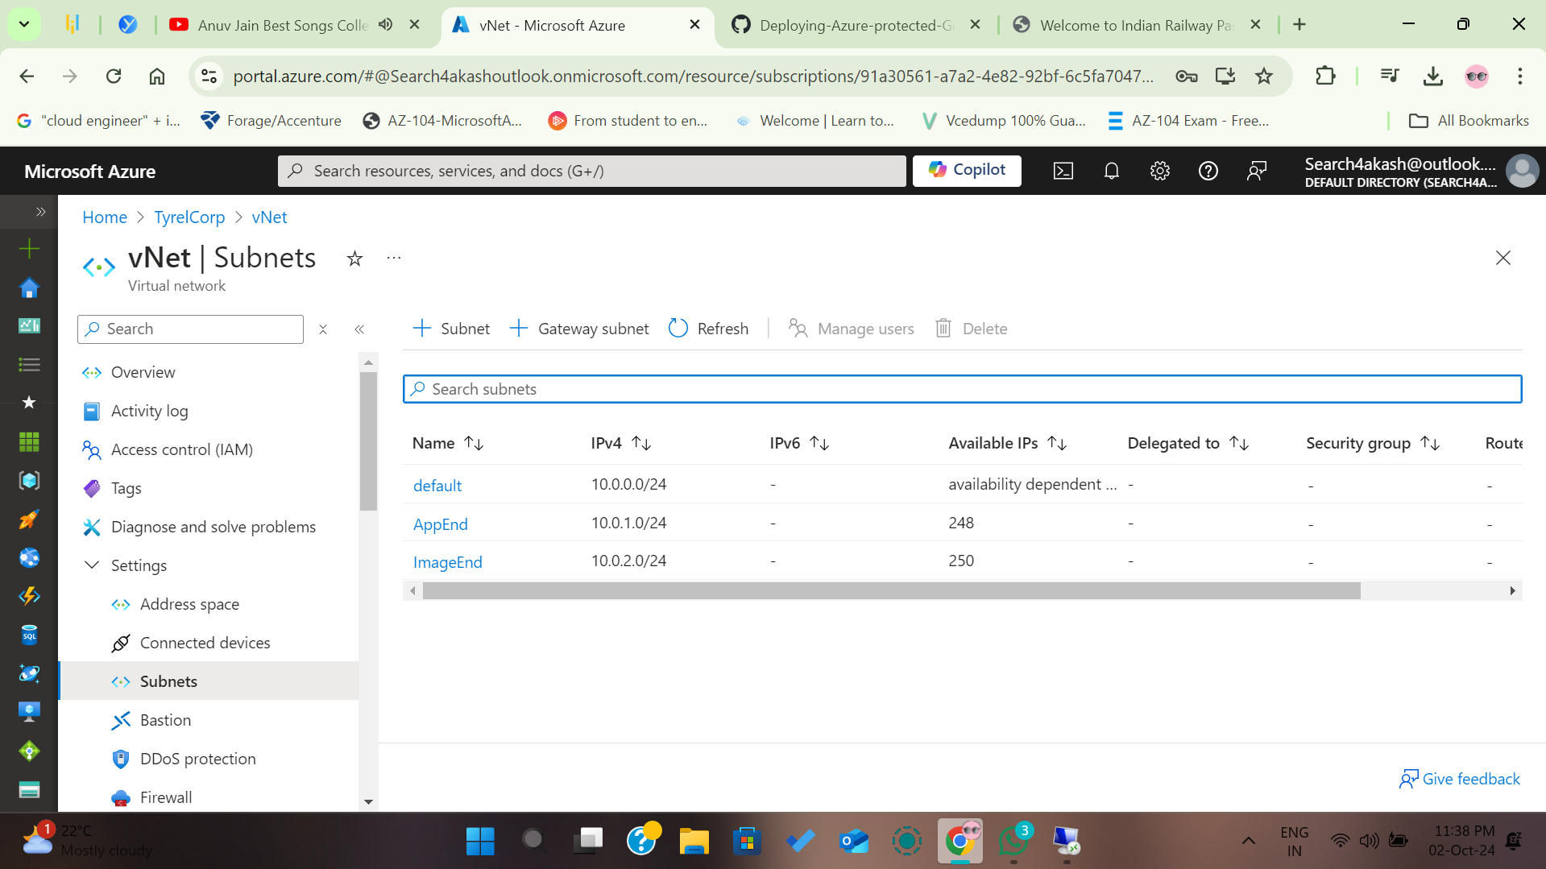
Subnets Cofig (AppEnd/Image/End)
Akash Majumdar

Slide 12
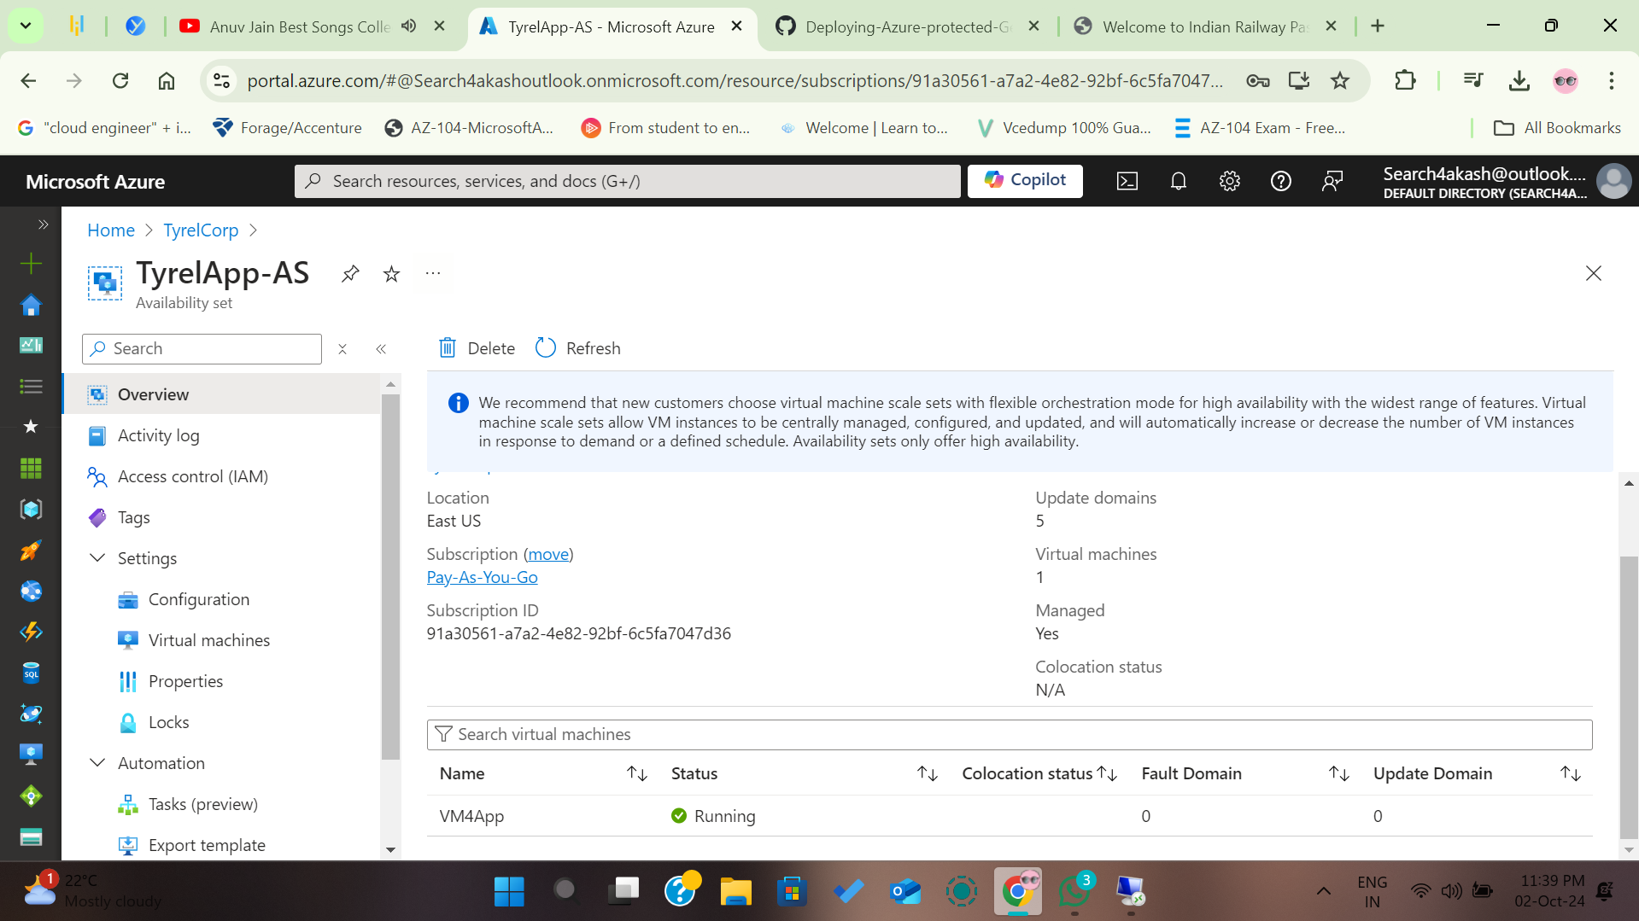
Availability Set - App
Akash Majumdar

Slide 13
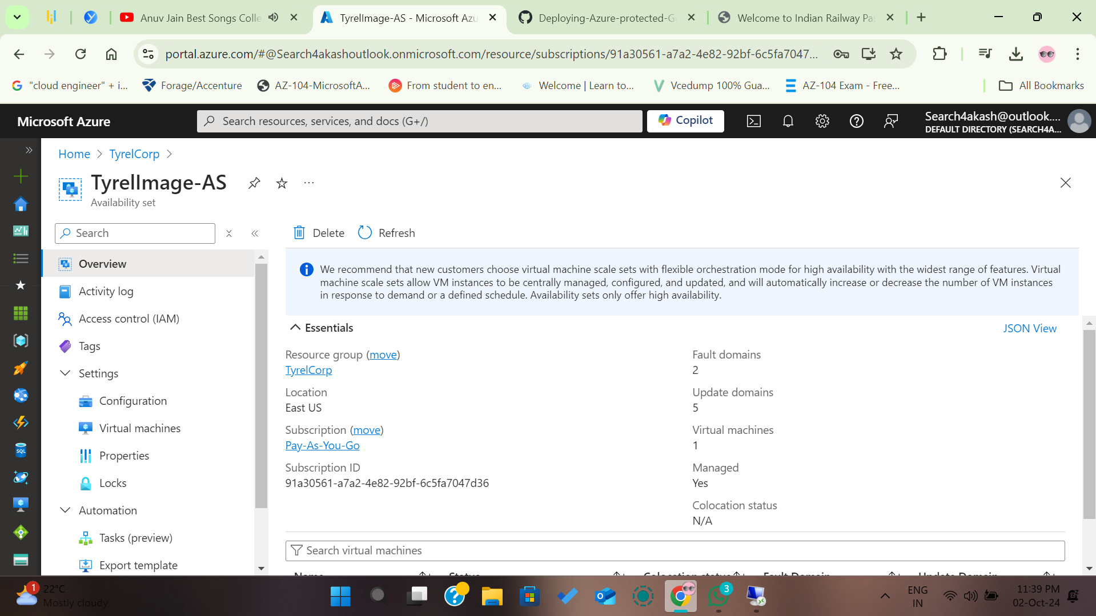
Availability Set - Image
Akash Majumdar

Slide 14
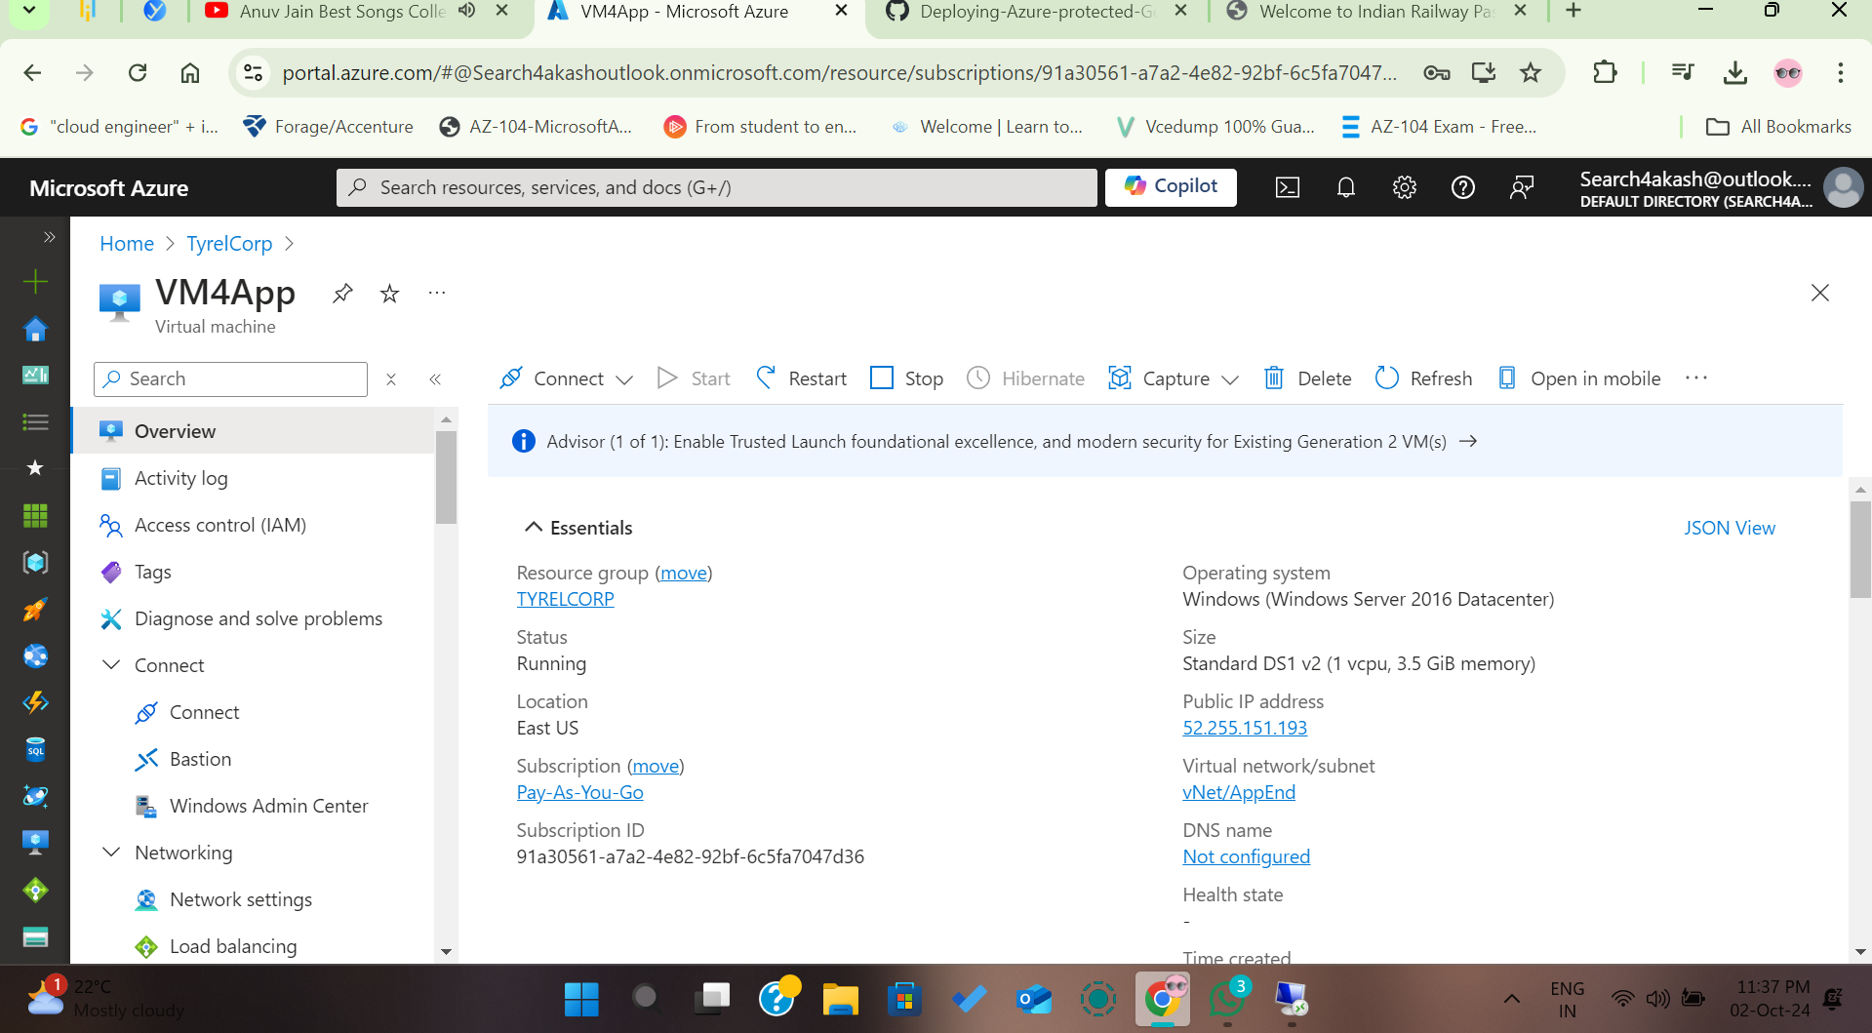
Virtual Machine - App
Akash Majumdar

Slide 15
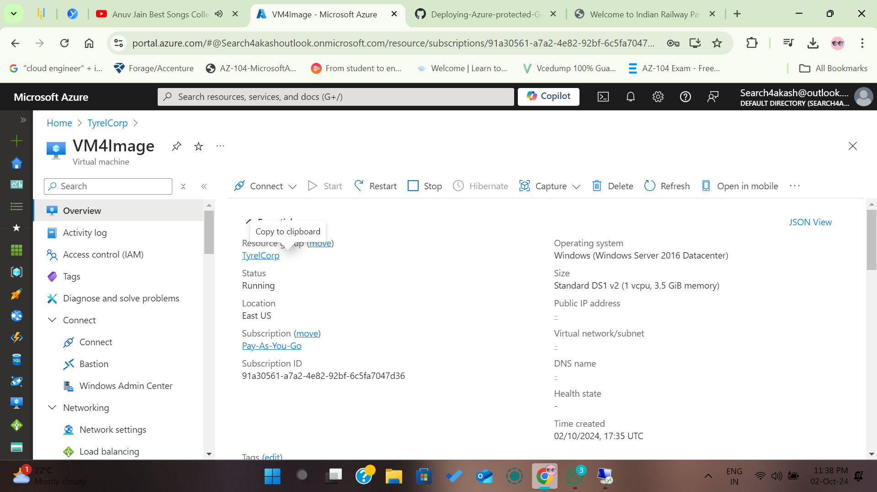
Virtual Machine - Image
Akash Majumdar

Slide 16
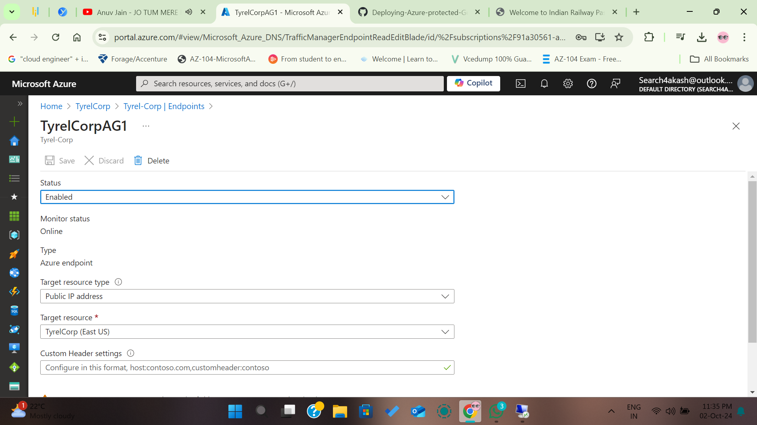
TyrelCorp - EndPoints
Akash Majumdar

Slide 17
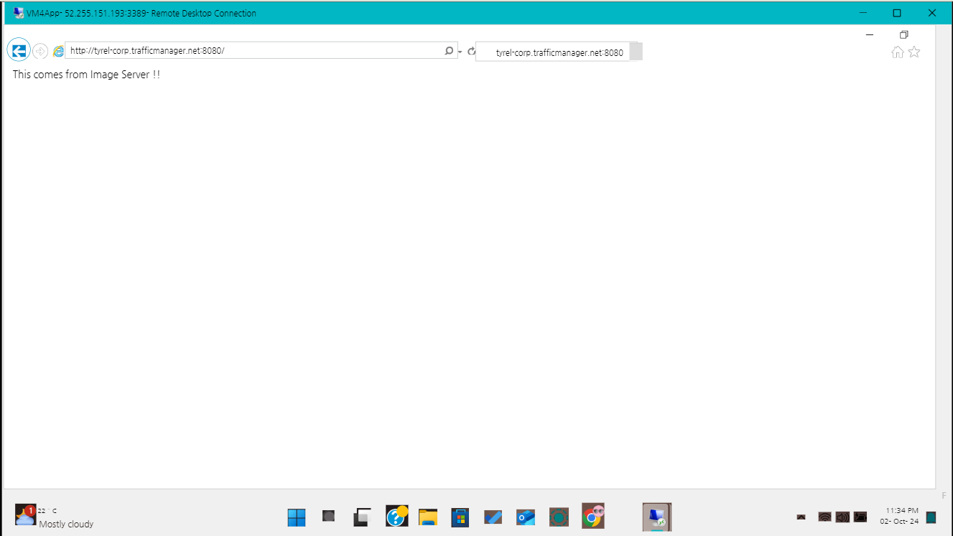
Testing on :8080 port/Image Server
Akash Majumdar

Slide 18
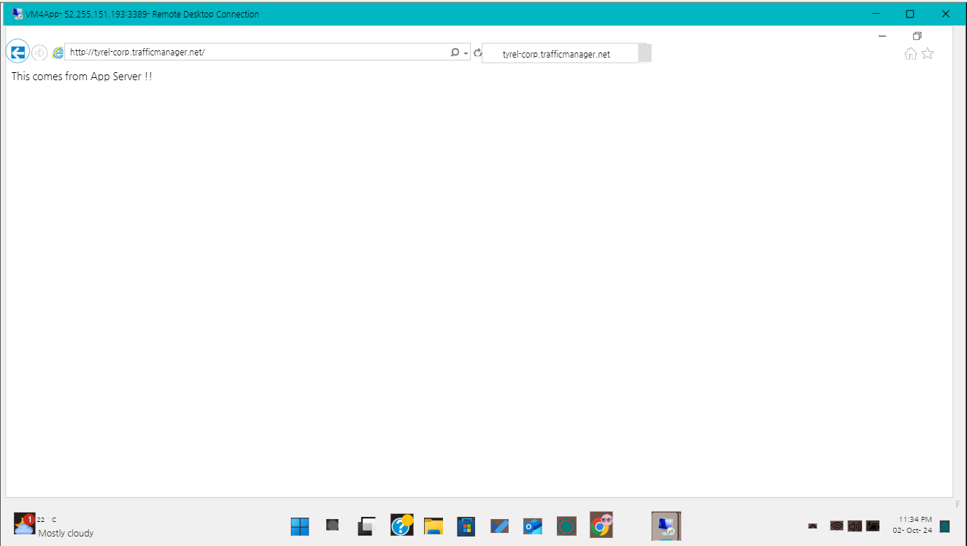
Testing/ App Server
Akash Majumdar

Slide 19
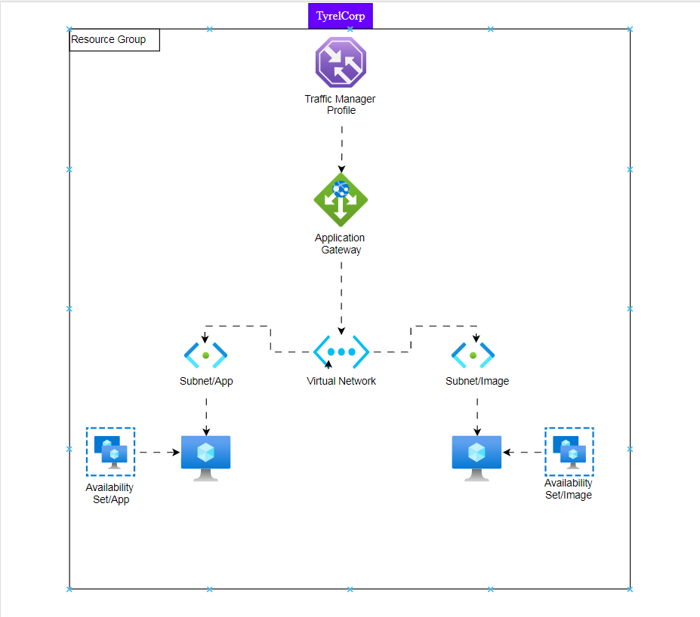
Template Visualisation
Akash Majumdar

Slide 20
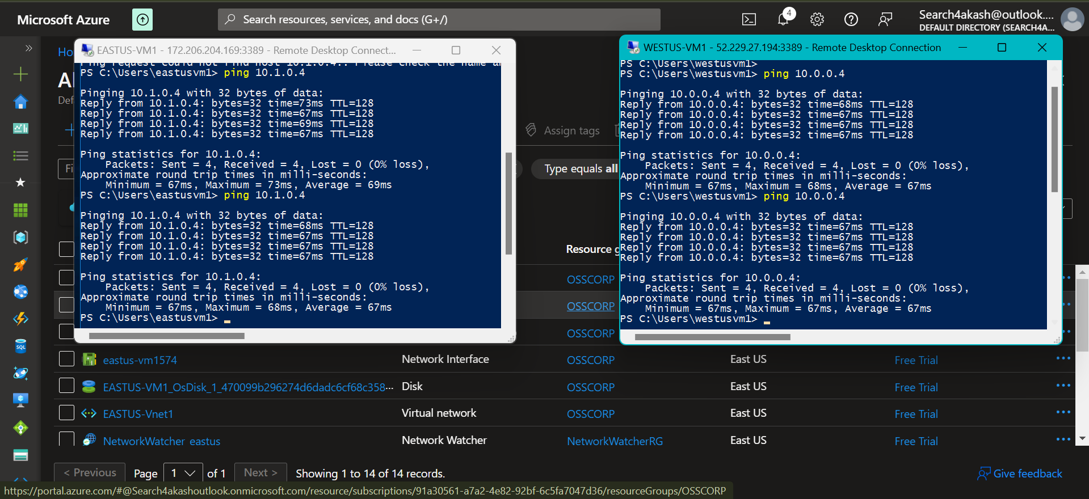
Ping Test | EastUS-VM1—WestUS-VM1
Akash Majumdar

Slide 21
Thank You ☺

